Slide 1
TRANSITS I
Organisational Module
Notes:
Maintainers of this module on behalf of TF-CSIRT:
Sigita Jurkynaitė <sigita.jurkynaite@gmail.com>
Don Stikvoort <don@elsinore.nl>
Changes, comments, please e-mail to both maintainers or add to the github repository. Thank you!

Slide 2
Whois
Name of trainer 1, affiliation
Bio in a few bullets
Name of trainer 2, affiliation
Bio in a few bullets
Notes:
OPTIONAL SLIDE for the trainers to introduce themselves, if not done elsewhere in the training yet

Slide 3
Learning Objectives
Learn about CSIRT background and why we need it
Learn important CSIRT starting points and positioning within the organisation
Gain an overview of CSIRT organisational aspects (SIM3 based)
Gain an overview of CSIRT human aspects (SIM3 based)
Notes:
TRAINER: you can present this slide very short, or hide it if you wish as learning objectives are mostly important for the trainer. It IS a valid idea to check during the training and towards the end if the participants “got it” - i.e. if you reached your learning objectives. Best way to check this is by asking “backtrack questions” in a casual way in the course of the module, as there is no exam after this module.
To structure this training module, we used the 4MAT system in this presentation: simply put, ordering the presentation in the sequence Why ➔ What ➔ How ➔ What if. This slide with learning objectives is the start of the Why section.
For more info on the 4MAT system see e.g. the ENISA “Good Practice Guide on Training Methodologies” (https://www.enisa.europa.eu/publications/good-practice-guide-on-training-methodologies), or 4MAT guidance which you can find online easily. 4MAT is also used in the trainer-training that has been used in TF-CSIRT and FIRST over the past 10+ years, and which now is part of the OCF/TF-CSIRT portfolio.

Slide 4
Session Plan
Why CSIRT ?
Starting Points & Basics
Basics & Exercise
Organisational Factors
Human Factors
Wrap-up
Notes:
TRAINER: keep this very short, the training is about your content, not the ToC. A slide like this is mostly useful for those students who need solid structure to satisfy their personal learning needs (every student is different in the way they learn).

Slide 5
Why CSIRT ?
Why incident management ?
Notes:
TRAINER: in the 4MAT system we are still in the Why section. The Why is extra important for the organisational module, as this module really lays the Why foundation for the whole TRANSITS I training. Which is also the reason that whenever possible, this module should be taught first (can be done after an introductory group exercise, like the ENISA roleplay), or at least (e.g. when the training is done in 2 parallel groups) at an early stage in the training.

Slide 6
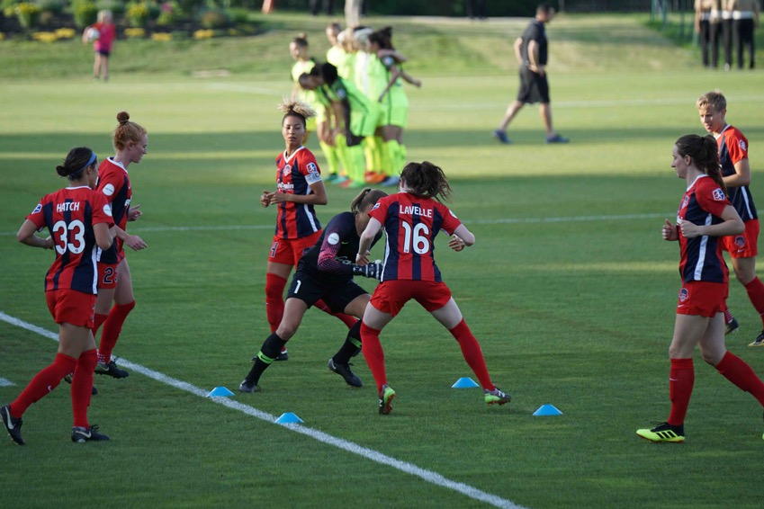
Let’s get to know each other some more
Photo by Jeffrey Lin on Unsplash
Notes:
TRAINER: in a relaxed fashion (tip: come closer to your audience – use stage anchoring as in trainer-training) ask the following questions in the plenary – make your own choice, depending on the audience – add your own as you see fit :
1. Do you read more than 2-3 articles on cyber security per week?
2. Who comes from a country with a national CSIRT?
3. Who thinks vendors are responsible for the software they write?
4. Who thinks governments (should) play a role in cyber security?
5. Who thinks banks should cooperate on cyber attacks?
TRAINER could come up with your own introduction, or game, for the same purpose – be creative! See the next slide for potential inspiration.

Slide 7
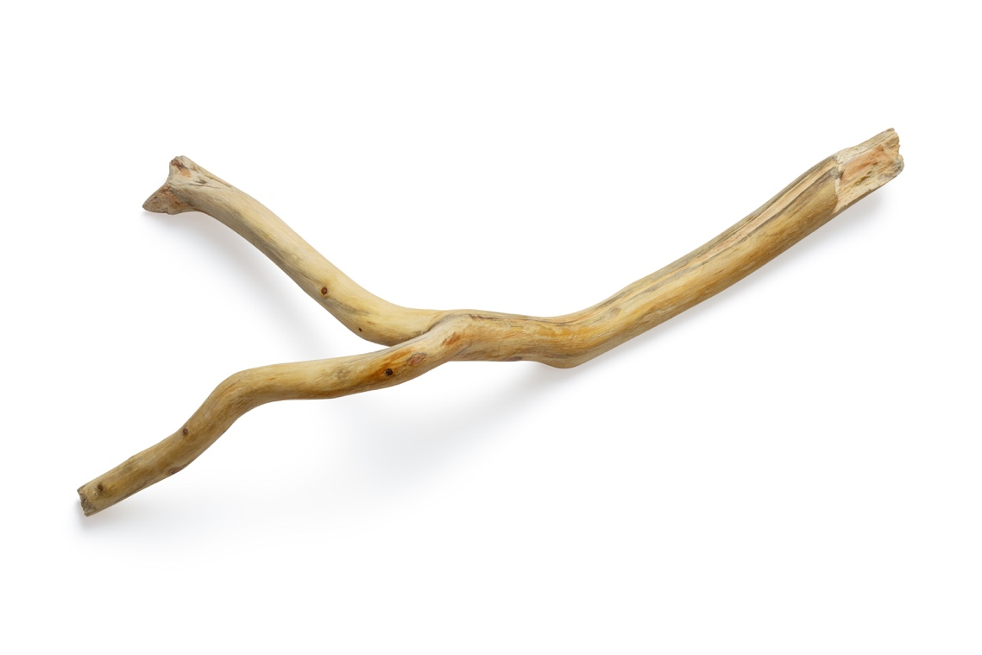
The Helium Stick
Notes:
OPTIONAL SLIDE as potential ALTERNATIVE to the previous slide (with the football team pic), especially to be used if the training has not had an icebreaker or get-to-know-each-other exercise yet. It goes like this:
Line up the group in two rows which face each other. Introduce the Helium Stick - a long, thin, light rod (you need to bring this rod with you!). Ask participants to point their index fingers and hold their arms out. Lay the Helium Stick down on their fingers. Before you let go, get the group to adjust their finger heights until the Helium Stick is horizontal and the Helium Stick is touching everyone's index fingers. Explain that the challenge is to gently lower the Helium Stick to the ground together. The catch: Each person's fingers must stay in contact with the Helium Stick at all times. Pinching or grabbing the pole in not allowed - it must rest on top of all fingers ☺

Slide 8

What is it you want to protect ?
Groups of 4 :
7 minutes discussion
Discuss in plenary
Photo by Samuel Zeller on Unsplash
Notes:
NOTE: this exercise can also be done fully in plenary – just use a flipover or whiteboard then to write down the input from the audience.
TRAINER: create the groups (3 to max 5 per group) in such a way that they can easily move together without too much fuss – as it’s only a short exercise. Let them talk about what they, or the IM team they represent, actually wants to protect. After the 7 minutes, shortly discuss in plenary. Clues as to possible replies:
Primary process
Customers, Employees, Identities
Products, Contracts
Supporting processes
Reputation
Information, infrastructure
Critical infrastructures
Health, lives
And many others options!
Highlight some of the above as you see fit, if the groups don’t mention them.

Slide 9
Internet history : need for incident management & governance
196X: ARPANET
1988: Morris Worm led to creation of CERT et al.
2003: World Summit on the Information Society
1998: CSIRT Handbook
1996: Aleph1: “Smashing the Stack for Fun and Profit”
1984: creation of global DNS
2001: TF-CSIRT started & Budapest Convention signed
1989: FIRST founded
1993: start of collaboration of teams in Europe
2000: Burst of Dot-Com Bubble
2005: Internet Governance Forum (IGF)
2012: WCIT-12 in Dubai (governance)
2007: Cyber attack on Estonia
2015: GFCE
2017: 1st IoT botnets
2010: Stuxnet
>2021: AI
Timeline courtesy Serge Droz
Notes:
NOTE: the next slide is an ALTERNATIVE to this one. Use which one suits you most as trainer!
TRAINER: updated timeline, left out details. do not go too much into detail! Explain and stress how the history and growth of the Internet led to:
the need for incident response or IR: just putting out the fire!
which naturally grew into incident management or IM: including not just response but also prevention, detection and lessons learnt (just like the fire brigades developed too!)
and more recently, as the matrix becomes increasingly complex not only connecting security teams but in fact all realms of society worldwide, the need for 21st century style governance, where “CSIRTs meet politics, business, society”
NOTE that 21st century governance style does not equate old style hierarchical governing: this simply does not work on the Internet, and whenever it’s used seems to lead to compartmentalization, censorship and “shutting off”.
Some background info:
The Internet grew out of an earlier experiment, called ARPANET. Some crazy people (mostly academics) had the idea to connect computers. Only in 1984 global DNS was introduced by Paul Mockapetris, Zaw-Sing Hu and Jon Postel, which made scaling possible (before that we had host files). The first “cybercrime” (not intended as such) happened in 1988, when the Morris Worm paralyzed the net. This led to the creation of the first Computer Emergency Response Team CERT (now called CERT/CC). Others followed and already one year later FIRST was founded. The Internet really started to take off in the mid 90s and many hackers turned to it (there was hacking before the Internet). In 1996, Aleph One published his paper “Smashing The Stack For Fun And Profit” in the Phrack magazine. His techniques showed how to exploit a very common security hole (a buffer overflow). The problem remains with us today. In 1998 the CSIRT handbook was made public by Kossakowski, Stikvoort & West-Brown. The term CSIRT was coined by them to circumvent the term CERT, which was trademarked by CMU (host to CERT/CC). All the rest is recent history.

Slide 10
Internet history : need for incident management & governance
1970s
1980s
1990s
2000s
2010s
2020s
ARPANET
Birth of the commercial antivirus
The world goes online
Threats diversify and multiply - national teams, cyber legislation and governance emerge
The decade of hacking
Cybersecurity continues to grow at the speed of light ...
Notes:
OPTIONAL SLIDE as an ALTERNATIVE to the previous one. Use which one suits you most as trainer!
TRAINER: explain and stress how the history and growth of the Internet led to:
the need for incident response or IR: just putting out the fire!
which naturally grew into incident management or IM: including not just response but also prevention, detection and lessons learnt (just like the fire brigades developed too!)
and more recently, as the matrix becomes increasingly complex not only connecting security teams but in fact all realms of society worldwide, the need for 21st century style governance, where “CSIRTs meet politics, business, society”
NOTE that 21st century governance style does not equate old style hierarchical governing: this simply does not work on the Internet, and whenever it’s used seems to lead to compartmentalization, censorship and “shutting off”.
Some background info:
The Internet grew out of an earlier experiment, called ARPANET. Some crazy people (mostly academics) had the idea to connect computers. Only in 1984 global DNS was introduced by Paul Mockapetris, Zaw-Sing Hu and Jon Postel, which made scaling possible (before that we had host files). The first “cybercrime” (not intended as such) happened in 1988, when the Morris Worm paralyzed the net. This led to the creation of the first Computer Emergency Response Team CERT (now called CERT/CC). Others followed and already one year later FIRST was founded. The Internet really started to take off in the mid 90s and many hackers turned to it (there was hacking before the Internet). In 1996, Aleph One published his paper “Smashing The Stack For Fun And Profit” in the Phrack magazine. His techniques showed how to exploit a very common security hole (a buffer overflow). The problem remains with us today. In 1998 the CSIRT handbook was made public by Kossakowski, Stikvoort & West-Brown. The term CSIRT was coined by them to circumvent the term CERT, which was trademarked by CMU (host to CERT/CC). All the rest is recent history.

Slide 11
Do you have a choice ?
Can you choose not to deal with security incidents ?
Do you like to react more than to prevent ? Do you just love to fight fire ?
So you agree that incident management is the way to go
We refer to ourselves in that community as “CSIRTs“: would you prefer to use a term no one understands ?
You need a CSIRT capability to manage incidents
This module is there to help you :
make your CSIRT fit your local needs
make your team more effective
Notes:
TRAINER: best to treat questions one after the other, allowing breaks for students to think (Animation could be added to roll off the questions one by one).
Note (and explain if needed) that IM is: prevention, detection, correction (response) and lessons learnt, feeding back into prevention. IM is a whole lot more than just response.
Also if needed make clear that a CSIRT capability can be organized in more ways – as separate team, or embedded in one way or another (in a bigger cyber security team for instance, which could also host a SOC capability).

Slide 12

CSIRT means : to organise incident management
To organise incident management in the CSIRT way means to organise :
IM Awareness on all levels
Authority
Escalation
External Contacts (CSIRTs, police, etc.)
Photo by Josh Calabrese on Unsplash
Notes:
Awareness: to organise the awareness on IM on all levels (management, constituents, press office, etc)
Authority: make sure you know what you are allowed to do and who’s backing you up.
Escalation: when things go wrong, reach the right people quickly, also outside business hours.
External contacts: to avoid confusion and undesired actions, it’s crucial to organise this well. It e.g. doesn’t have to be the CSIRT that contacts the police, it just needs to be clear who does that and under what conditions.

Slide 13
Starting Points
Key references and other starting points
Notes:
TRAINER: in the 4MAT system (as taught in trainer-training) this is the start of the What section. This is the theory, and in terms of the SIM3 model we mainly treat the O and H parameters here.

Slide 14
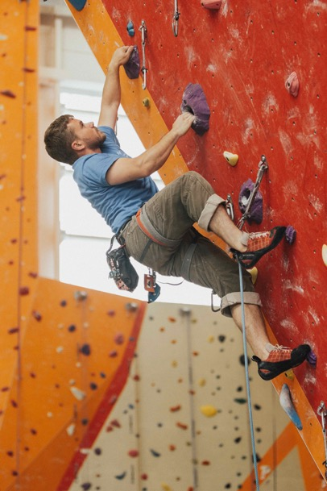
Starting point #1 : human
The CSIRT work is a many faceted and challenging craft
CSIRT members need :
1. Technical skills and experience
1. Communication skills
2. Trust building skills ➔ human networks
3. Common sense
4. Creativity, thinking outside the box
5. At times: stamina
Photo by roya ann miller on Unsplash
Notes:
TRAINER: shortly explain all 6 (the two times a #1 is NOT an error but on purpose), and the order: of course you could change the order slightly, it’s not meant to be cut in stone. To most of these aspects the training will come back.
Creativity and trust building are probably the factors that make the CSIRT craft so fascinating and are certainly important reason that people keep coming back to the CSIRT community.
Explain that “trust” is based on interpersonal relationships – NOT on organisational bonds, or on x509 certificates, etc

Slide 15
Question
What is the difference between CERT and CSIRT ?
Notes:
TRAINER: this slide is meant as open question to the audience. The next slide explains that there is NO DIFFERENCE

Slide 16
Starting point #2 : terminology
CERT : Computer Emergency Response Team
Origin 1988, later trademarked, but only in the USA and Canada
CERT Coordination Center (CERT/CC)
Recommend to nicely ask: “Contact CERT/CC Security Operations (security-operations@cert.org) for CERT partnership details” (recent quote from CERT/CC)
CSIRT : Computer Security Incident Response Team
Origin 1998 : http://www.cert.org/archive/pdf/csirt-handbook.pdf
Free to use as has never been claimed, and now near impossible to “own” the term
nCSIRT, gCSIRT, NCSC, IHT, SIRT, CIRT, IHC …. all CSIRTs
ISAC: like a CSIRT that does analysis and sharing, but no actual response/coordination
SOC: similar to a CSIRT but specialises on the detection element
PSIRT: vendor team, specialises on fixing vulnerabilities in the *ware that they sell
What’s in a name – you must have this capability !
Notes:
NOTE: Kossakowski, Stikvoort and West-Brown created the term “CSIRT” around 1997 to avoid the trademarked “CERT” in the CSIRT Handbook (published 1998). Hence no meaning difference between the two terms.
For the use of ”CERT” by US entities, refer to: https://www.sei.cmu.edu/education-outreach/license-sei-materials/authorization-to-use-cert-mark/ - for others it is recommended to just nicely ask (see slide above) but that is not mandatory.
TRAINER: explain additional to CSIRT, also SOC, ISAC, PSIRT. Simplified:
ISAC = Information Sharing and Analysis Capability. ISACs are teams that serve communities, and are much like a community CSIRT but without doing IR or incident coordination - they specialise on the information analysis and sharing bit, leaving the IR/IM to their constituency.
SOC = Security Operations Center. Grew out of NOCs. SOCs specialise on incident detection and are therefore more found in those places where they can monitor networks. However when a SOC detects threats or incidents, they must make sure something happens based on that: if they do that themselves they are really also a CSIRT – alternatively they can hand it over to a CSIRT. Or CSIRT/SOC are combined. In general they are really not that different, it depends on the definition of their services based on the FIRST Services Framework.
PSIRT = Product Security Incident Response Team. PSIRTs are vendor teams that focus on vulnerability management. Note that companies like Cisco, Apple, MS, Huawei etc will have both PSIRTs (to deal with vulnerabilities in their products) as well CSIRTs (to deal with their own internal security).

Slide 17
Question
Is an nCSIRT or NCSC very different from other CSIRTs ?
Notes:
TRAINER: open question to the audience. The answer is that it’s not really different – just usually national teams are bigger teams, and expecially when they call themselves NCSC they usually are connected with the country’s cyber crisis management. Sometimes national teams think they are very different because they do more incident coordination than resolution, but this is not a major difference – they still need to detect, analyse, find resolution tactics, disseminate and coordinate. And this is not different from many other not-national CSIRTs - even internal CSIRTs often don’t do the actual resolving themselves, but leave that to the IT department.

Slide 18
Starting point #3 : SIM3
Organisation
Human
Tools
Processes
SIM3 = Security Incident Management Maturity Model
For (self) assessment,
membership criteria &
audit purposes (including Certification)
45 parameters in 4 categories
O – Organisation : 11
H – Human Aspects : 7
T – Tools : 10
P – Processes : 17
Current is SIM3 v2 interim: see https://opencsirt.org/csirt-maturity/sim3-and-references/
Notes:
TRAINER: note that SIM3 v2 is only called “interim” (date: Jan 2023) because it serves only one profile of IM teams, namely the CSIRT/CERT profile. Just as SIM3 v1 did since it was written back in 2008. This profile, and SIM3, works still quite well for ISACs, to some reasonable extent also for SOCs, and to a lesser extent for PSIRTs, but these are not ideal matches. Therefore in 2024/25, three new profiles will be added to SIM3: ISAC, SOC and PSIRT. Thus optimising SIM3 for all 4 types of profiles – and this will be labelled SIM3 v2 “full”. Also note that this taxonomy of the 4 main types of IM teams was stabilised by FIRST in 2023, as part of work done in the FIRST Framework Development SIG: see https://www.first.org/standards/frameworks/csirts/team-type
TRAINER: we focus in this training module on the Organisational and Human parameters

Slide 19
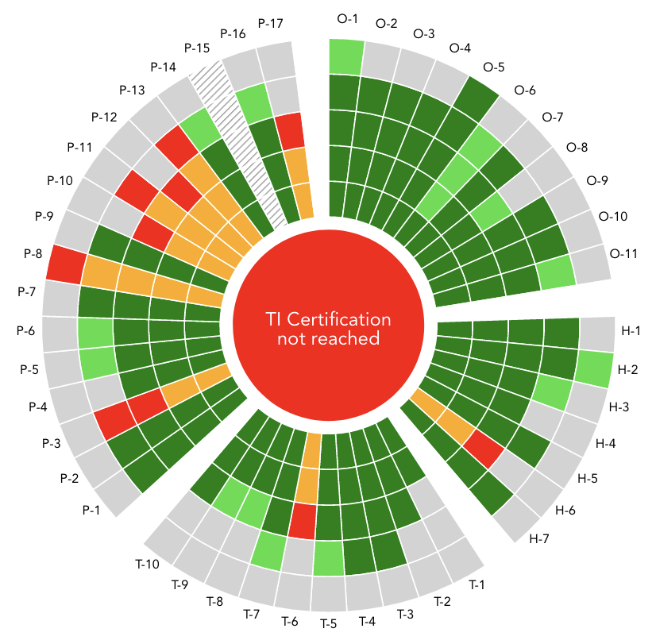
SIM3 ctd.
Each parameter can score on these Levels:
0 = not available / undefined / unaware
1 = implicit : “between the ears”, not written
2 = written down but not formalised (draft)
3 = like 2 but approved by CSIRT management: “rubberstamped” (or published)
4 = like 3 but actively controlled/audited on authority of governance levels above the CSIRT management on a regular basis (or in national law explicitly)
Try this out: https://sim3-check.opencsirt.org
Diagram courtesy OCF
Notes:
TRAINER: note that level 4 is the hardest one to explain and grasp, even for Certified SIM3 Auditors. What in Level 4 is essential are 3 things: actively audited, on authority of higher governance, and regularly. That a parameter is approved by higher governance does not make it Level 4. If the team does a self assessment and sends the report to higher governance, does not make Level 4. Etcetera. (The one exception, usually only for national teams, perhaps also for sectorial ones – is when the topic of a SIM3 parameter is explicitly mentioned in national law. We then assume that the parliamentary/judicial system of that country will warrant the same or better than what Level 4 intends to do – and therefore it is Level 4 then. However notice that explicitly is in bold: if the law is not explicit or vague, this does not warrant Level 4.)
The best current explanation on the Levels 0 to 4 is found in the SIM3 v2 interim reference manual: https://opencsirt.org/wp-content/uploads/2023/11/SIM3_v2_interim_standard.pdf

Slide 20
Starting point #4 : FIRST CSIRT/SOC/ISAC Services Framework
FIRST Services Framework v2.1 https://www.first.org/standards/frameworks/csirts/csirt_services_framework_v2.1
Enumerates in depth the kind of “services” that an IM team can deliver to their constituency (their clients)
Designed to fit perfectly for CSIRTs (CERT/CDC/NCSC/etc) but works just as well for SOCs and ISACs
SIM3 and the Service Framework do not compete but go perfectly together: SIM3 describes the whole range of 45 maturity parameters – the Services Framework is an in depth survey of the O-5 parameter!
Serv.framework
SIM3
O-5
Notes:
TRAINER: know that now, early 2024, the FIRST Framework Development SIG discusses possibly dropping “CSIRT” from the current official name of the Services Framework as that is unnecessarily limiting: it really works for CSIRT as well as for SOC and ISAC. The outcome of this is not determined yet, as it may lead to “religious wars” inside FIRST.
NOTE: more info on the Services Framework follows under the slide down below about ”Services”, the SIM3 O-5 parameter.

Slide 21
Basics & Exercise
Basic concepts leading into a group exercise
Notes:
TRAINER: we are still in the 4MAT system What section.

Slide 22
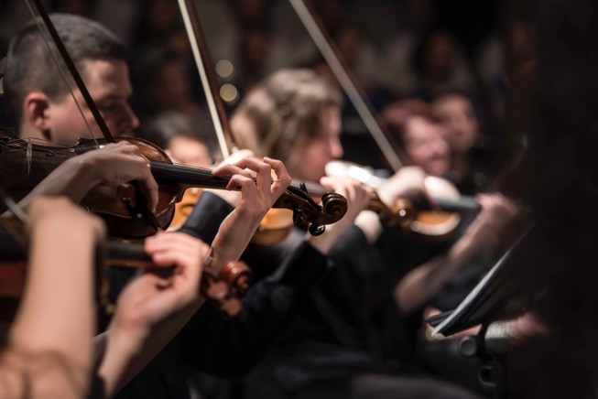
For your CSIRT to make sense you must understand your organisation
Incident management is about your organisation !
It’s not primarily about computers, routers and networks
It is about you and your boss and the receptionist and all others, it’s about your products and services, it’s about your customers and shareholders
Your CSIRT wants to prevent and cure incidents
So you need to know and understand your organisation
Hierarchy: How do units relate? Who is in charge?
Maze: Who are some of the key people you need to persuade?
Photo by Larisa Birta on Unsplash
Notes:
TRAINER : in regard “maze”, realise that in (most) any organisation there are key people who are not managers. Often, experts who have been around for a long time, and are just not the “manager type” (often they tried a function like that and didn’t like it). Get them on your side – their influence is unseen but real. And by the way – if you want to get anything done in an organisation, be aware that in a different way, secretaries are key people too ... you could ask the audience why that is the case.

Slide 23
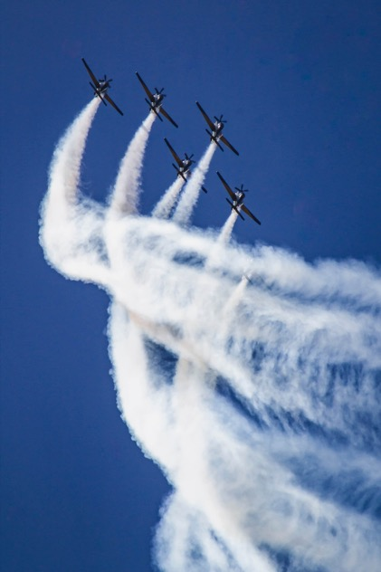
Organisation of security
“Security is not a product it is a process” – Bruce Schneier
See security as a holistic challenge – not fragmented
“integrated security”, “TSM” etc.
Information security has many actors: CISO, CSIRT, IT department, SOC, etc.
Physical security
Business continuity Management (BCM)
Risk Management
Crisis Management
End-responsible = board / CEO / Minister / …
Photo by María Noel Rabuñal Cantero on Unsplash
Notes:
TRAINER: note that BCM concepts have been added to SIM3 v2 interim in various parameter descriptions/explanations.

Slide 24
Security Management Cycle
Make sure you implement a cycle like this
DO the feedback and ensure FOLLOW UP
CSIRT can contribute to …
Risk Analysis
Security Plan
Evaluation
Security Policy
Risk Analysis
Security Plan
Implementation
Feedback
Audit & Evaluation
Diagram courtesy S-CURE
Notes:
TRAINER : it happens regularly that the feedback loop leads to costed proposals – that then get delayed a year or more due to budgeting cycles. Make sure that in the budgeting there is a reserve for implementing security improvements: these are not optional in many cases!
CSIRT members can make important contributions to this cycle as they know what can go wrong and what went wrong – this is invaluable knowledge and experience.

Slide 25
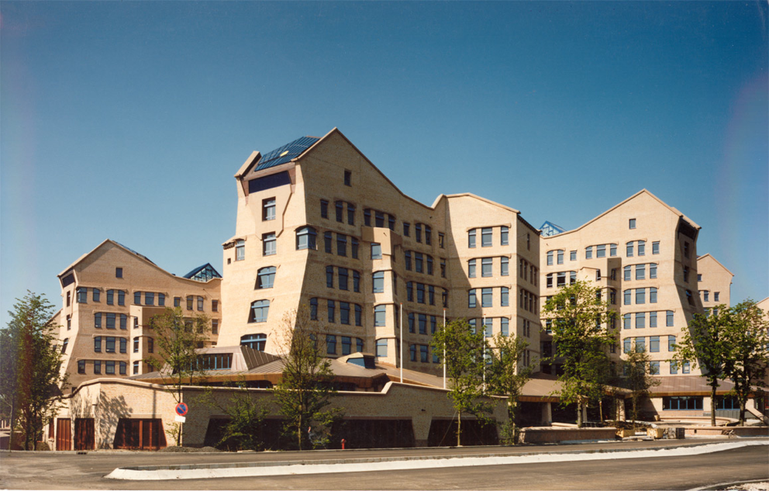
CSIRT as spaceship
Board
Accountancy
IT
CSIRT
Physical
Security
Diagram courtesy OCF
Notes:
TRAINER: explain that this organisation pic lacks the departments/divisions/faculties – it’s a diagram intended to point out the importance of the board (end-responsible for security), accountancy (checking not only on money but more and more also on the organisation of IT and security), physical security (visible to board members, unlike infosec) – and IT. IT usually includes the CSIRT though the CSIRT can also be e.g. a staff function. The CSIRT is however unique in that it WORKS FOR THE WHOLE ORGANISATION and needs to be able to CONTACT MOST of that organisation. That’s why the image of the “CSIRT as spaceship” is so apt: the CSIRT is like a spaceship that can fly through the whole organisation - unlike normal functions of IT, that are hierarchically embedded, is the CSIRT in some ways like a “free radical”. Whenever you try (and this has happened in real cases, time and again) to bind the CSIRT to the normal hierarchy of an organisation, this CSIRT is bound to fail.

Slide 26
Example: PariSto Bank
CEO
Director France
Director Sweden
CIO
CISO
Head of IT
Head of IT
CSIRT
?
Head Networks & Systems
Head Networks & Systems
Sysadmin
CSIRT
?
Diagram courtesy S-CURE
Notes:
TRAINER : the PariSto bank does not exist, it was invented for this training. This bank has just discovered it needs a CSIRT, e.g. because of e-banking having started (many midsize and smaller banks don’t have CSIRTs yet). The board has tasked the CISO with forming the CSIRT – and the CISO is wondering whether to do that at the c-level (in the c-level building), or somewhere in the IT departments of France or Sweden. All these options are feasible and have pros and cons, that the students will discover in the exercise that is to follow. Therefore this diagram is meant to lead into the exercise!

Slide 27
Exercise (30+ minutes)
Split into groups of 3-4
In each group :
Choose one of your CSIRTs and discuss (= exercise purpose)
Mandate : how and by whom was your CSIRT mandated ?
Constituency : who do you work for ?
Authority : what is your team allowed to do ? What “power” do you have ?
Responsibility & Services : what is your team expected to do ? what services does your team offer to the constituency in order to fulfil that responsibility ?
Place of team in organisation : where do you fit in ? Does this set-up work well ?
Plenary wrap-up (discuss only one highlight per group discussion)
Notes:
TRAINER: the plenary wrap-up is not meant to get all the answers from each group – this takes too long and is boring. If there is time, ask each group to highlight ONE (at most 2) interesting aspect of their discussion. Every now and then you will have to – nicely and politely – stop students who still want to tell everything they have discussed in their tracks and get them to focus on the highlights.
NOTE: this exercise leads from the 4MAT system What into the How.

Slide 28
Organisational Factors
The main organisational factors to bear in mind
Notes:
TRAINER: we are now in the 4MAT system How section.

Slide 29
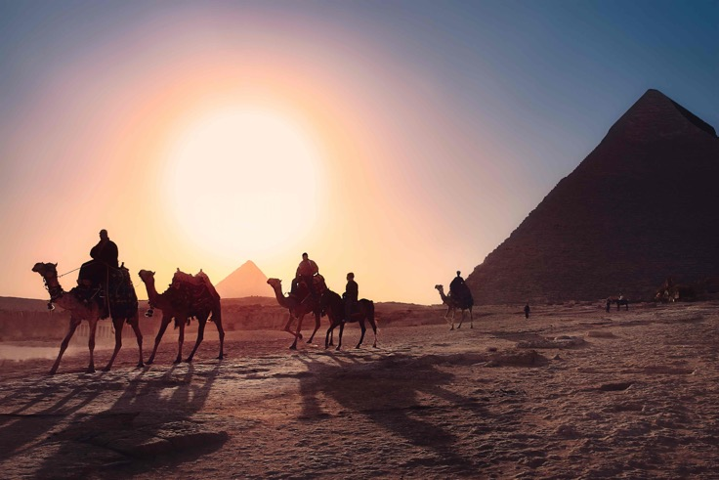
Mandate (SIM3 O-1)
CSIRT Mandate should come from Board level
For national teams best anchored in legislation
And/or national cyber security/resilience policy
Funding also needs to be anchored at high level to ensure continuity
Photo by Simon Matzinger on Unsplash
Notes:
Note: the idea of the pic is that you need the “Pharaohs” to get your mandate.

Slide 30
Constituency (SIM3 O-2)
Who does your CSIRT work for, what is the target group ?
Main types of constituencies:
National/CI : serving the country, or at least the critical infrastructure
Sector : serving a specific sector like e.g. the energy sector (usually inside a country)
Government
Military
Academia : serving universities, research institutes, schools, libraries, etc.
Own organisation/corporation : most commonly found all over society/business
Paying customers : offering commercial CSIRT services
PSIRTs (Product Security Incident Response Teams) are special case
Notes:
TRAINER: CI = Critical Infrastructure

Slide 31
Authority (SIM3 O-3)
Authority – what is your team allowed to do
Advise only ?
Power of escalation ? - you need that if you can’t enforce …
Power of enforcement ? (e.g. blocking)
Authority must come from highest governance level (not from head of IT)
Have a “CSIRT charter” document approved and rubberstamped
CISO role is intermediary between CSIRT and Board
Authority is not the key factor to success, but it can help. Al Capone: a gun and a good argument is better than just a good argument ☺
Notes:
TRAINER: consider explaining here that in general CSIRTs should stay away from punishment/repression. This should not be part of their authority. The reason is simple: if CSIRTs can “punish”, then employees (or teams, e.g. telcos in case their sectoral CSIRT is in the regulator) will stop reporting incidents whenever they may feel they could have done “a better job”. You need to create a trust relationship where people feel encouraged and safe to report. Of course, especially internal CSIRTs may play a role in analysis of incidents that MAY lead to “punishment”, but that should follow very strict procedures and be on request of people who have that authority, usually being management.

Slide 32
Responsibility (SIM3 O-4)
reactive :
Incident handling
Alerts & warnings
Vulnerability handling
Artefact handling
pro-active :
Announcements
Technology watch
Audits/assessments
Tools maintenance
Security tool development
Intrusion detection
quality management :
Risk analysis
Business continuity planning
Security consulting
Awareness building
Education/training
Product evaluation/certification
No team is responsible for all of these !
List from CERT/CC and ENISA : https://resources.sei.cmu.edu/asset_files/WhitePaper/2002_019_001_53048.pdf
Notes:
TRAINER: this is the old services list from the CSIRT Handbook, used by CERT/CC on their website – and also by ENISA. They are not presented as services here, to give room for the FIRST CSIRT Services Framework on the next slide. However this old list is still a useful checklist to see what a team is responsible for, and what not. Hence used in this context. You can also refer to it as an alternative (older) list of services, if you wish.

Slide 33
Services (SIM3 O-5)
FIRST Services Framework: works for CSIRT etc / but also for SOC and ISAC
https://www.first.org/standards/frameworks/csirts/csirt_services_framework_v2.1
Service areas: (subdivided in services and then functions)
InfoSec Event Management – the traditional SOC area
InfoSec Incident Management – the traditional CSIRT area
Vulnerability Management – more specialised, only few teams do this in full
Situational Awareness – making sure you are not blind and deaf
Knowledge Transfer – at least part of this is essential for any and all IM teams
rfc2350 : strong advice to fill it out
Operational factsheet of your CSIRT (services and contact data)
Place publicly on your team’s webpages in your native language and English
Notes:
TRAINER: explain why rfc2350 should be filled out and made public, in English (plus native language, if you like).
Examples for rfc2350:
https://english.ncsc.nl/publications/publications/2019/juli/02/operational-framework-and-rfc2350
https://www.kyberturvallisuuskeskus.fi/en/our-activities/cert/rfc-2350
https://csirt.bsn.go.id/assets/rfc2350/rfc2350-en.pdf
https://www.uu.nl/sites/default/files/rfc2350-cert-uu-20210720.pdf
https://www.cncs.gov.pt/pt/certpt/rfc-2350-en/ but also in native Portuguese: https://www.cncs.gov.pt/pt/rfc-2350/
Etcetera, just google

Slide 34
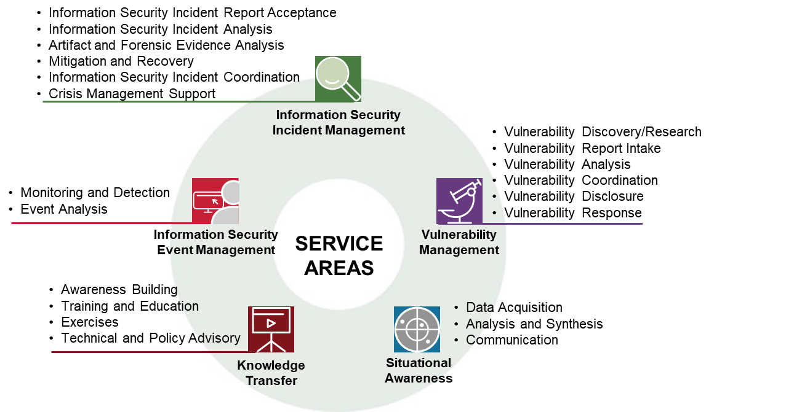
FIRST Services Framework: Service Areas and Services (Functions left out)
Notes:
NOTE: you can hide this slide if you don’t have time to elaborate on the Services Framework. Very useful to treat it though!
TRAINER: this picture is from the Framework, and depicts the 5 Service Areas, with the Services for each of the Service Areas. Missing are the Functions here, which are the next (and last) level “down” from the Services. Best treat them in this order:
Information Security Event Management: this is in essence the SOC service area! A classical SOC specialises on this stuff – BUT really always a SOC does more, also services from especially Situational Awareness and Knowledge Transfer.
Information Security Incident Management: this is in essence the CSIRT service area! A traditional CSIRT specialises on this stuff – BUT like with the SOC, a CSIRT does more, certainly services from Situational Awareness and Knowledge Transfer, but also a CSIRT needs forms of ”detection” in order to be able to solve incidents … so unless they get input from a SOC in the same organisation (or subcontracted), they will probably do elements from the Event Management as well. Some CSIRTs also do (elements of) Vulnerability Management.
Vulnerability Management: a more specialised activity, the specialty of PSIRTs. However several bigger CSIRTs do this too, CERT/CC is a famous example. And really any CSIRT should at least do “Vulnerability Report Intake” and then decide what to do with that, even if that just means sharing it inside the community in the hope that another team or vendor picks it up.
Situational Awareness: elements of this service area will be done by all types of IM teams as without it the team would be partially blind and deaf. This service area is the specialty of ISACs, who are not into the actual IR.
Knowledge Transfer: elements of this service area will be done by all types of IM teams as without knowledge transfer our work is not of much use ☺

Slide 35
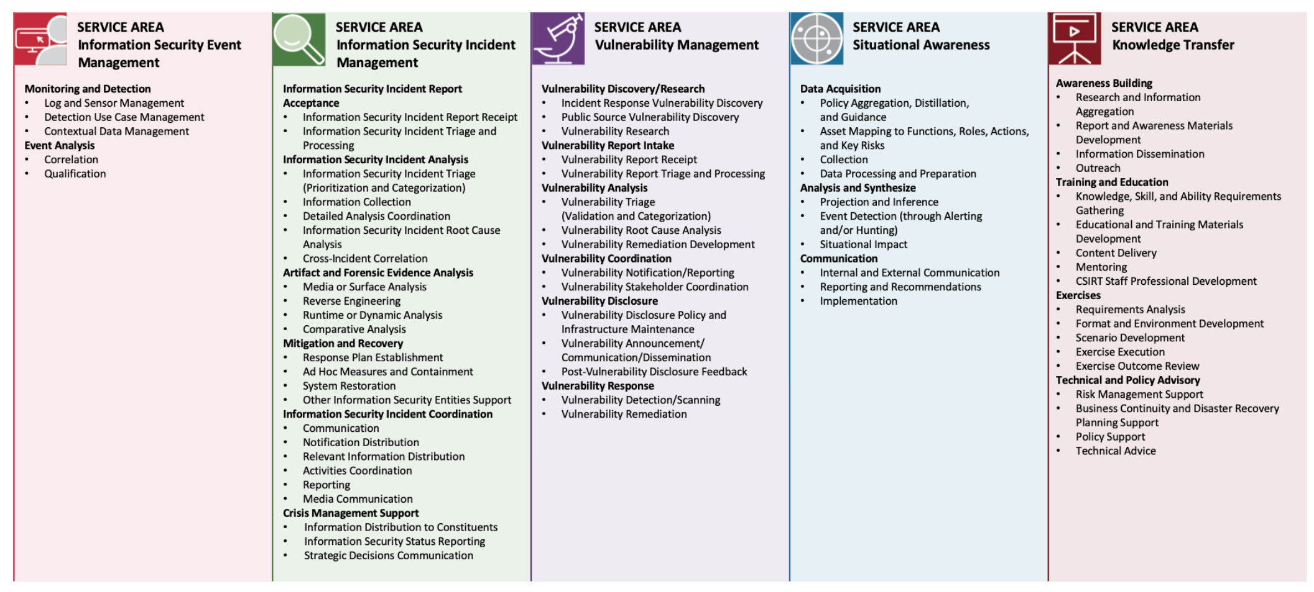
FIRST Services Framework: Service Areas, Services and Functions
Notes:
OPTIONAL SLIDE if you have time to dive deeper into the Services Framework. This pic also includes the Functions. Do NOT go into details!

Slide 36
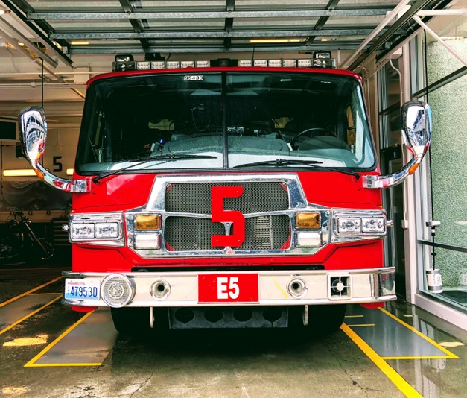
CSIRT core service(s)
Incident Management : essential function for any CSIRT
May consist of any or all of :
Incident response coordination
Incident response support
Incident response on site
Incident analysis
Forensic evidence collection
Tracking
Photo by John Cameron on Unsplash

Slide 37
IM Service cycle
Incident prevention
Awareness raising, audits, port and vulnerability scans, advisories, …
Incident detection
IDS sensors, firewall alerts, point-of-contact, …
Incident resolution
Incident co-ordination, on site handling, …
Incident quality management
Team meetings, lessons learnt, recommendations, …
Feeds back to incident prevention
Notes:
NOTE: you can HIDE this slide if pressed for time, leaving it out does not disrupt the argument

Slide 38
PSIRT core service
PSIRTs deal with broken things
FIRST PSIRT Services Framework recommends starting with:
Vulnerability Management Policy (as covered in ISO30111)
Information Handling Policy (as covered in ISO/IEC 29147)
Vulnerability Scoring/Prioritization Policy
Remediation Service Level Agreement
Vulnerability Disclosure Policy (usually a public documentation)
See https://www.first.org/standards/frameworks/psirts/FIRST_PSIRT_Services_Framework_v1.1.pdf
Notes:
NOTE: you can HIDE this slide if pressed for time, leaving it out does not disrupt the argument
TRAINER : PSIRTs deal with vulnerabilities in the products sold by their host organisation. Think “Patch Tuesday”. So their services will revolve around detecting, assessing and remediating vulnerabilities.

Slide 39

Public Media Policy (SIM3 O-6)
Do you have a communication department who talk to Radio, TV, newspapers etc. directly? Are you involved to avoid “nonsense”?
What about social media? Which ones do you handle?
Not all media mean well !
Photo by Onur Binay on Unsplash
Photo by Matt C on Unsplash
Notes:
TRAINER: discuss/explain that any IM team needs to think about which public media they want to use themselves (X, FB, web, etc.) and which ones they want to work together with, and how (TV, radio, newspapers, etc.). This is the public media policy, a new parameter (O-6) in SIM3 v2 interim.
HINT: the following is a video that shows how you can never know who you are really talking to and what their motives are:
Think before you link (on connecting on social media): https://www.youtube.com/watch?v=J1FD8bxfg1Y

Slide 40
Service levels (SIM3 O-7)
Most basic one: when is the service provided ?
24/7 : expensive & only useful when also applies to IT operators
Office hours only : 09 to 17, 08 to 20 or similar
Out of hours coverage
For emergencies only (who decides?)
Best effort is always better than no effort
Other service levels
Probably dependent on incident classification !
(Human) reaction time
Resolution time : be very careful
Notes:
TRAINER : be very careful with defining service levels based on resolution times as the graph of the number of incidents vs the resolution times is not a Gauss curve, it’s asymmetrical: a small percentage of problems stays open a very long time, making the average resolution time much longer than you would expect. You could replace this by a service level like: 90% of the incidents needs to be solved within so-and-so-much time - that allows the remaining 10% to hold those cases that take a long time in solving (often due to factors outside the power of the team).
TRAINER: understand that normally speaking you need the incident classification before deciding on the service levels (next slide! SIM3 O-8)

Slide 41
Incident classification (SIM3 O-8)
How do you classify incidents ? ( = taxonomy )
Classical taxonomies focus only on technical incident types. The ENISA taxonomy is a good example and also used in MISP and other tools: https://github.com/enisaeu/Reference-Security-Incident-Taxonomy-Task-Force/blob/master/working_copy/humanv1.md
Internally oriented approaches also take the impact of an incident/event into account. Possibly also the priority.
KISS! Limit the number of classes of impact as much as possible, say to max 2 or 3.
If you also add priority, KISS is even more important.
If you don’t, you end up with lots of complexity for your service levels and processes.
Classification can be used for service levels, reporting, writing IM processes, …
Interesting paper: https://www.thecroforum.org/wp-content/uploads/2016/06/ZRH-16-09033-P1_CRO_Forum_Cyber-Risk_web.pdf
Notes:
TRAINER : explain that higher impact incidents usually need a higher level of service (faster handling, at least). In older classifications without impact this can also be reached by for instance prioritising certain types of incidents, like a DDoS
TRAINER: explain how an overly complicated O-8 will lead to lost time in the registration and post-processing, to overly complicated service levels and IM processes (as must take into account all the permutatations of the Classification), etcetera. Keep It Simple!

Slide 42







Participation in CSIRT systems (SIM3 O-9)
Global level ➔
Notes:
TRAINER: use this to stress the great importance of national (not in the images! but essential!) and international cooperation for CSIRTs.
Explanation of logos, and note that most of these teams have CERT or CSIRT in the name but NONE of them is a CSIRT – they are all cooperations and membership organisations of some kind, none of them does actual IM (though some, like TF-CSIRT, do spread such info when it reaches them - but that’s best effort and not part of their normal mandate).
Global level, lowest line:
FIRST as worldwide forum, the only global “club” of CSIRTs
ITU runs a national CSIRT development program, mostly in the global south
GFCE (Global Forum for Cyber Expertise) brings together nation states including their cyber diplomats (!), big tech companies (usual suspects), the big accountancy/consultancy firms, but also the IM community (FIRST, OCF and others)
The Americas: LACNIC, the IP## registry for Latin America, there is a good cooperation for all types of CSIRTs called Lacnic Csirt; the Organisation of American States (OAS) runs a programme for national teams called CSIRTAmericas
Africa: AfricaCERT is the oldest cooperation but still lacks the kind of status that APCERT or TF-CSIRT have. TrustBroker Africa (TBA) uses the same software as TF-CSIRT and has in 2023 started to list teams in their database - accreditation is foreseen to soon happen too. Both TBA and AfricaCERT are open to all types of CSIRTs.
Asia: APCERT is a long standing and successful cooperation, but only for n/g/s teams.
Europe: TF-CSIRT is the oldest regional cooperation, tracking back to 1993, and has a successful membership system with “listed” and ”accredited” teams – plus an optional status of “certified” which can only be reached after a successful SIM3 certification (and needs to be repeated every 3 years). Not shown, but the EU has a cooperation of n/g/s CSIRTs named “CSIRTs Network”.
Not organied by a clear geographical region: OIC-CERT, the CSIRT cooperation of the Organisation of the Islamic Cooperation

Slide 43
CSIRT charter (SIM3 O-10)
Write a charter (organisational framework) for your CSIRT
Essential to clearly define your CSIRT and prevent discussions when incidents happen
High level description
Mandate, constituency, authority, responsibility, services, structure & place of team
“CSIRT Handbook” is good background material : https://insights.sei.cmu.edu/library/handbook-for-computer-security-incident-response-teams-csirts/
Example NCSC-NL : https://english.ncsc.nl/publications/publications/2019/juli/02/operational-framework-and-rfc2350
Notes:
TRAINER: note that in the example the old word for organisational framework or charter is being used, namely operational framework. This old word is not the best as one would expect tools and processes in an operational framework.

Slide 44
Charter ctd : structure of team
Central (most common)
CERT-BDF (serving Banque de France)
Distributed
SURFcert (serving SURF, Dutch NREN)
TeliaCERT and “sub-CERTs” (serving Telia Company ISP & telco operator)
ThaiCERT (serving Thailand: government & national)
MSCERT (Microsoft PSIRT: in Redmond)
Notes:
NOTE: you can HIDE this slide if pressed for time, leaving it out does not disrupt the argument

Slide 45
Charter ctd : place of team in organisation
Most common : part of IT department
Remember : CSIRT is a spaceship
Mission and authority must be anchored at highest governance level
Ensure good working relationships & direct escalations with :
Your constituents, through established contacts in all entities of the constituency
Line management (your boss)
Highest governance level e.g. through CISO
PR staff (press contacts)
Legal department & privacy officer
Sometimes : organisation support function
Great place to be for mandate, authority and escalations
But: leave your ivory tower !
Notes:
NOTE: you can HIDE this slide if pressed for time, leaving it out does not disrupt the argument
TRAINER: see slide “CSIRT as spaceship” (currently slide 24)

Slide 46
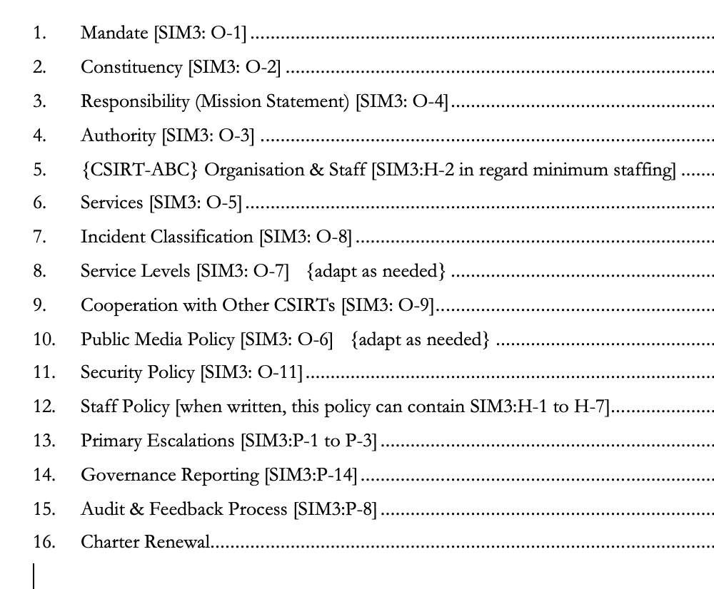
Charter example ToC
Charter example
ToC
Notes:
TRAINER: Open CSIRT Foundation can provide a free Word template for the Charter, that teams can use and adapt to their own needs. Write to info@opencsirt.org

Slide 47
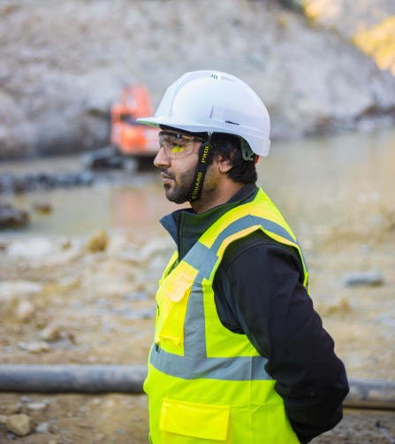
Security Policy (SIM3 O-11)
Typically a formal approach
ISO27001
National standard
NIST Cybersecurity Framework
Preferably (also) have your own CSIRT security policy
CSIRT has special needs
Testing, port scanning
Honeypot
Extra fallback facilities
Make sure to cover BCM !
Photo by Ahsan S. on Unsplash
Notes:
Trainer: BCM = Business Continuity Management

Slide 48
Human Factors
The main human/staff factors to bear in mind
Notes:
TRAINER: we are still in the How section.

Slide 49
Exercise (15 minutes)
Split into same groups of 3-4 as before
In each group :
One member makes a few notes for wrap-up
Choose one of your CSIRTs and discuss (= exercise purpose)
What challenges do you face in meeting your requirements for staffing ?
Do you know the skillset for the staff you need and have appropriate job descriptions ?
Is there a policy for hiring and developing CSIRT staff ? So not just generic ?
Do you have access to technical training / training budget for your staff ?
Can you get apart from technical training also training in “soft skills” ?
Plenary wrap-up (discuss only one highlight per group discussion)
Notes:
NOTE: you can HIDE this slide and skip the exercise if pressed for time.
TRAINER: the plenary wrap-up is not meant to get all the answers from each group – this takes too long and is boring. If there is time, ask each group to highlight ONE (at most 2) interesting aspect of their discussion. Every now and then you will have to – nicely and politely – stop students who still want to tell everything they have discussed in their tracks and get them to focus on the highlights. If there is not enough time select the questions that they need to cover.

Slide 50
Code of Conduct (SIM3 H-1) & TRUST
The human factor is the prime factor in the success of any CSIRT
Trust is one of the key factors in successful CSIRT cooperation
Your CSIRT takes at least a year to build trust and can lose it overnight
Trust is built on personal relationships, not on organisational ones
Make sure you hire people that not only you trust, but other teams will trust too (think twice about hiring ?former? Blackhats)
Use a Code-of-Conduct and discuss it with your team each year : e.g. https://www.trusted-introducer.org/TI-CCoP.pdf or. https://ethicsfirst.org/
TLP - Traffic Light Protocol : active knowledge and use required : https://www.first.org/tlp/

Slide 51
Staff Resilience (SIM3 H-2)
Need enough team members to cover for holidays/illness
SIM3 says minimum 3 (can also be part-timers)
Burnt-out team members are not effective
Always have a plan B (discussion)
CSIRT work can be challenging – what to compensate
Offer appropriate rewards
Keep work varied
Budget for trainings
Let staff attend events
Notes:
TRAINER: discuss the plan B with the students! Don’t spell it out for them, let them think about it out loud in the group. Plan B should have become easier thanks to the learnings we all had to take from when Corona hit in 2020

Slide 52
Skillset (SIM3 H-3)
What skills are needed?
General: common sense, communication, diplomatic, quick learner, stress resistant, team player, integrity, owns up to mistakes, problem solving, time management, …
Technical: to match what the CSIRT offers
Skillset description for each job profile
(Senior) incident handler, researcher, general manager, …
Save time by using FIRST’s “CSIRT Roles and Competences”, based on the FIRST Services Framework:
https://www.first.org/standards/frameworks/csirts/FIRST_CSIRT_Services_Roles_and_Competencies_v_0.9.0.pdf
Or consider: https://infosecskillsmatrix.com/rolesskills
Need other resources ?
Specialist skills (e.g. forensics), legal, crisis management, …
Arrange before an emergency hits
Notes:
TRAINER : skills depend on your site infrastructure and you may be able to recruit from existing support staff. Plan for training and staff turnover.
Checking the history of recruits can be difficult and varies from country to country – often you have to just try them and see. Have defined procedures for joiners and leavers to regulate system access, if possible have them formally agree to workplace network monitoring.

Slide 53

Staff development (SIM3 H-4) & Technical and Soft Skills training (SIM3 H-5 and H-6)
Team & Personal development plan(s)
Staff development policy, including all aspects (SIM3 H-4)
Specific focus on skills development: technical (H-5), but also include “soft skills” (H-6) Soft skills are not soft at all
Budget & timeline
Feedback : commonly done by manager but consider having an experienced team member do feedback instead (less pressure, more coaching style)
Photo by Martine Jacobsen on Unsplash
Notes:
TRAINER: set up a good system of H-4 to H-6. Certifications are and can be useful, but pick what you find important. It is easy to overdo things, as is illustrated by this very useful (clickable) diagram :
https://pauljerimy.com/security-certification-roadmap/

Slide 54

Prime “soft” skill: human communication
THE MEANING OF COMMUNICATION IS
THE RESPONSE YOU GET (= the result)
Photo by Icons8 team on Unsplash
Notes:
TRAINER : this line is one of the presuppositions of NLP – NLP is a useful set of concepts and tools that can help people communicate better. There are more approaches that work. It’s not about NLP or any approach here – but this presupposition stands out in all approaches. What it means is simply what it says: and that means that whenever your communication isn’t getting through, isn’t working … then do not blame the receiving part, but instead wonder what you did wrong in your communication? Wrong timing? Too technical language? Examples in wrong context? You need to learn to understand your audience, their level, their worries, their needs, their language – so you can adapt your communication to be effective. Shouting in the phone as the man in this pic appears to do is probably NOT an effective means of communication.

Slide 55
External networking (SIM3 H-7)
SIM3 O-9 asks for participation in the national and global CSIRT cooperation(s)
SIM3 H-1 asks for trust building
All of that requires that team members go out and “network” with others:
In the constituency
In the memberships
Trainings, drills, meetings
Photo by Mapbox on Unsplash
Notes:
TRAINER: networking in person is crucial for the human CSIRT network to function, and for your CSIRT to function in the networks you are a part of. We are not AI or robots, we need at the end of the day physical meetings to build trust, get new ideas, build cooperations. “Online” can only do so much. We learnt that lesson clearly again during the Corona pandemic.

Slide 56
Wrap-up
Notes:
Wrap-up and start of the final What-if section.

Slide 57
Stay in the picture
Stay in touch with your constituency (SIM3 P-13 and P-15)
Presence on internal web pages (security, helpdesk), newsletters
Workshops, trainings once or twice per year
Visits, meetings
Stay visible for board and management (SIM3 P-14)
Quarterly and annual reports
War stories and statistics : add cost savings figures if possible
Stay visible for the world (SIM3 O-9, H-7 and P-17)
Membership of trusted fora
Your favourite national forum
Your favourite regional forum (TF-CSIRT, APCERT, etc.)
FIRST : http://www.first.org/
Go out there : meeting face-to-face is essential for building web-of-trust and to get better

Slide 58
Solving the puzzle takes …
90% of your time can be wasted on 10% of the question. Prioritise, brainstorm, focus on the desired outcomes – IM is not science. 10 or 20% of the puzzle pieces may give you enough to control the damage!
Have the courage to use your own mind*: take nothing for granted, not even from Insert Famous Name or an old and wise colleague : YOUR idea may be the difference that makes the difference.
* Immanuel Kant, 1724-1804.
Photo by Benjamin Zanatta on Unsplash

Slide 59


Stay informed
(Brian) Krebs on Security
The Hacker News
Dark Reading
We Live Security
Troy Hunt – Weekly Updates
Red Team Notes
(Bruce) Schneier on Security
Risky Business
Black Hills Information Security
SANS Daily
Re-thinking the Human Factor
Photo by Matthew Guay on Unsplash
Photo by Convertkit on Unsplash
Notes:
TRAINER: these are just some suggestions – share your own!

Slide 60
Reading List
SIM3 standard: https://opencsirt.org/csirt-maturity/sim3-and-references/
SIM3 online maturity tool & ENISA baselines: https://sim3-check.opencsirt.org/
FIRST Services Framework: https://www.first.org/standards/frameworks/csirts/csirt_services_framework_v2.1
RFC2350: https://www.ietf.org/rfc/rfc2350.txt
ENISA Reference Incident Classification Taxonomy: https://www.enisa.europa.eu/publications/reference-incident-classification-taxonomy
FIRST website: https://www.first.org/
TF-CSIRT Trusted Introducer website: https://www.trusted-introducer.org/
CSIRT Handbook: https://insights.sei.cmu.edu/library/handbook-for-computer-security-incident-response-teams-csirts/
NCSC-NL cyber security assessments: https://english.nctv.nl/topics/cyber-security-assessment-netherlands/documents
Cost of cybercrime: https://www.forbes.com/sites/stevemorgan/2016/01/17/cyber-crime-costs-projected-to-reach-2-trillion-by-2019/#6b99128b3a91
Insider threat: https://www.tripwire.com/state-of-security/security-data-protection/insider-threats-main-security-threat-2017/

Slide 61
TRANSITS I
Organisational Module
The End. Any questions ?

